Slide 1

CISC 250 – Business Telecomm Networks
WAN Technologies

Slide 2
Today’s Outline
WAN Purposes
WAN Choices
Leased Lines
PSDN
DSL
Cable Modem
FiOS
VPN

Slide 3
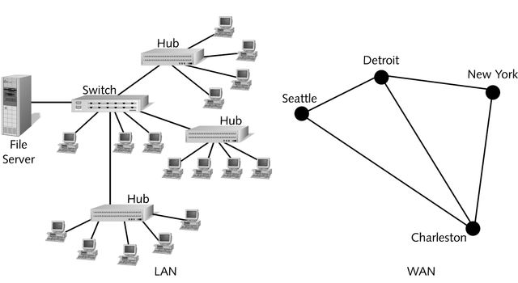
LAN vs. WAN

Slide 4
Wide Area Networks (WANs)
WAN Purposes
Link sites (usually) within the same corporation
Internet access
Provide remote access to individuals who are off-site
2.
Internet
Access
1. Link Sites
3.
Remote
Access

Slide 5
Wide Area Networks (WANs)
WAN Technologies
Ordinary telephone line and telephone modem.
Point-to-Point lines
Public Switched Data Network (PSDN)
Send your data over the Internet securely, using Virtual Private Network (VPN) technology
PSDN
VPN

Slide 6
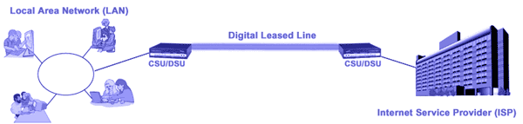
Leased Line Networks
Leased Line (Private Line or Dedicated Line)
Point-to-point connection
Always on
Fixed cost depending on speed and distance
Must be provisioned (set up). Can take weeks or months

Slide 7
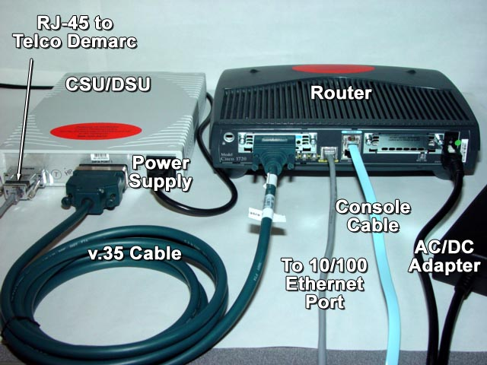
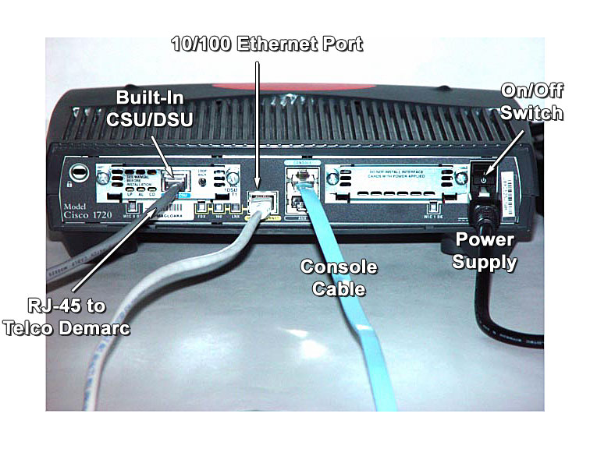
Leased Line Implementation
CSU/DSU: channel service unit/data service unit

Slide 8
Leased Line Choices
56 kbps Leased Lines
Fractional T1 lines offer low-speed choices between 56 kbps and T1, typically:
128 bps, 256 kbps, 384 kbps, 512 kbps, 768 kbps
T1 Leased Lines (1.544 Mbps)
T3 Leased Lines (44.736 Mbps)

Slide 9
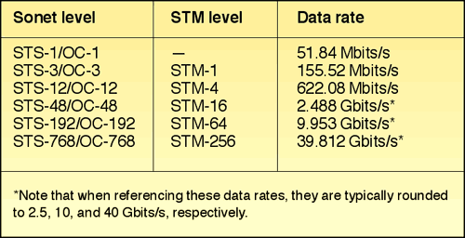
SONET (Synchronous Optical Networking) OC Leased Lines

Slide 10
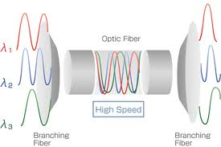
New Trend – DWDM
DWDM (Dense wavelength division multiplexing)
A technology that puts data from different sources together on an optical fiber, with each signal carried on its own separate light wavelength.
Higher Speed
(2.5 to 40 Gbps)*(16 or 32 or 128 or 160)

Slide 11
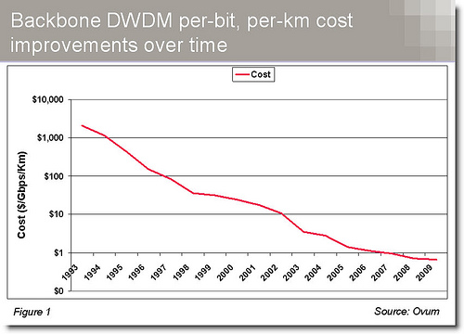
DWDM Cost

Slide 12
Leased Line vs. PSDN
Multi-site Leased Line Mesh Network
Site A
Site B
OC3 Leased Line
T3 Lease
Line
T1 Leased
Line
56 kbps
Leased
Line
56 kbps
Leased
Line
Site C
T1 Leased
Line
56 kbps
Leased
Line
Site D
Site E

Slide 13
Leased Line vs. PSDN
Public Switched Data Network (PSDN)
Site A
Site B
POP
POP
Public Switched Data
Network (PSDN)
Point of Presence
POP
POP
One leased
line per site
Site D
Site C
Site E

Slide 14
Leased Line vs. PSDN
Leased Line Network
Many leased lines
Individual leased line spans long distances
Company must plan, buy switching equipment, and operate the network
Public Switched Data Network (PSDN)
Only need one leased line from each site to a POP
Few and short-distance leased lines
PSDN carrier provides planning, switching, and operation of the network

Slide 15
PSDN technologies
Frame relay with speeds from 56 kbps to 40 Mbps
Asynchronous transfer mode (ATM) with speeds from 1 to 156 Mbps.
Ethernet with speeds from 10 to 100 Gbps

Slide 16
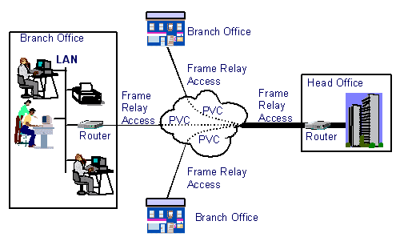
PSDN – Frame Relay
Designed to interconnect corporate customer LANs
Virtual Circuits (VC): “pipe” carrying aggregate traffic between two routers
Permanent VC (PVC)
Switched VC (SVC)
Corporate customer leases FR service from public Frame Relay network (eg, Sprint, AT&T)

Slide 17
Digital Subscriber Lines (DSLs)
Broadband speeds over existing telephone wire
Does not always work: distance limitations, etc.
Usually 3 miles – attenuation and noise
Can be fixed by repeaters
Where it does work, usually cheaper than leased lines

Slide 18
ADSL – Asymmetric DSL
Subscriber
Premises
Telephone Company
End Office Switch
downstream:
1.5 Mbps – 24 Mbps
Data
WAN
upstream
64 kbps – 3.5 Mbps
ADSL
Modem
PC
Splitter
Existing Telephone Wire
DSLAM
PSTN
Telephone
Ordinary Telephone
Service

Slide 19
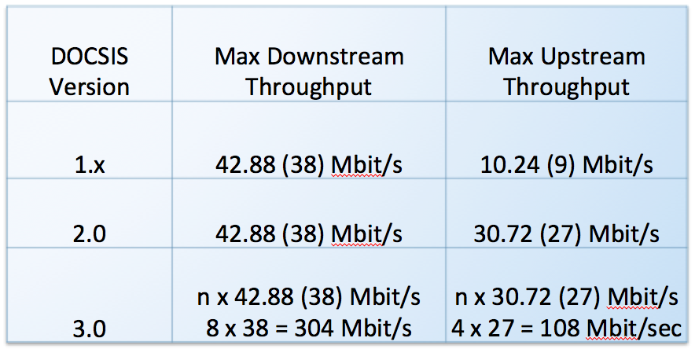
Cable Modem Services
Delivered by cable television operator
Asymmetric, high speed
Using Data Over Cable Service Interface Specification (DOCSIS) standard
Speed is shared by people currently downloading in a neighborhood
Speed Test http://www.speedtest.net/

Slide 20
Cable Modem Services
ISP
4. Coaxial
Cable to
Premises
2. Optical
Fiber to
Neighborhood
3.
Neighborhood
Splitter
1. Cable
Television
Head End
5. Cable
Modem
Subscriber
Premises
PC
6. Requires NIC or USB port

Slide 21







FiOS: Passive Optical Network (PON) Fiber to the Home Architecture
Central Office
Passive Outside Plant
Multi-dwelling units
Typically up to 20 km (28 dB)
Edge router
(data, video)
2.5 Gbps @ 1490 nm
splitters points
Small/medium enterprises
1.2 Gbps @ 1310 nm
Optical
Line Terminal (OLT)
Optional 1,550 nm to support local analog/digital video if required
Single family homes
Softswitch
(for voice)
Optical
Network Terminal (ONT)
Source: Fiber to the Home Council
Notes:
This slide was taken from a recent presentation to the FCC staff by the Fiber to the Home Council and shows the basic architecture of a Gigabit Fiber to the Premises System.
At its most basic level the Central Office uses an optical line terminal to bridge between the Internet and the passive optical distribution network, which in turn delivers service to the end users, whether they be in a multiple dwelling unit, a small or medium business, or a single family home.
The benefit of the GPON system is that no amplification of the "signals" is needed (i.e. it is passive). Active networks use amplifiers which amplify noise along with the desired signal. So the more distance a signal travels on the coax side of a HFC network, for example, the more amplifiers would be needed to get to the desired signal to the furthest point on the network and more noise would be introduced into the network.
The largest operator of GPON systems is Verizon, which has been upgrading many of its FiOS networks from the earlier generation architecture, BPON (broadband passive optical network), to GPON over the past year.

Slide 22
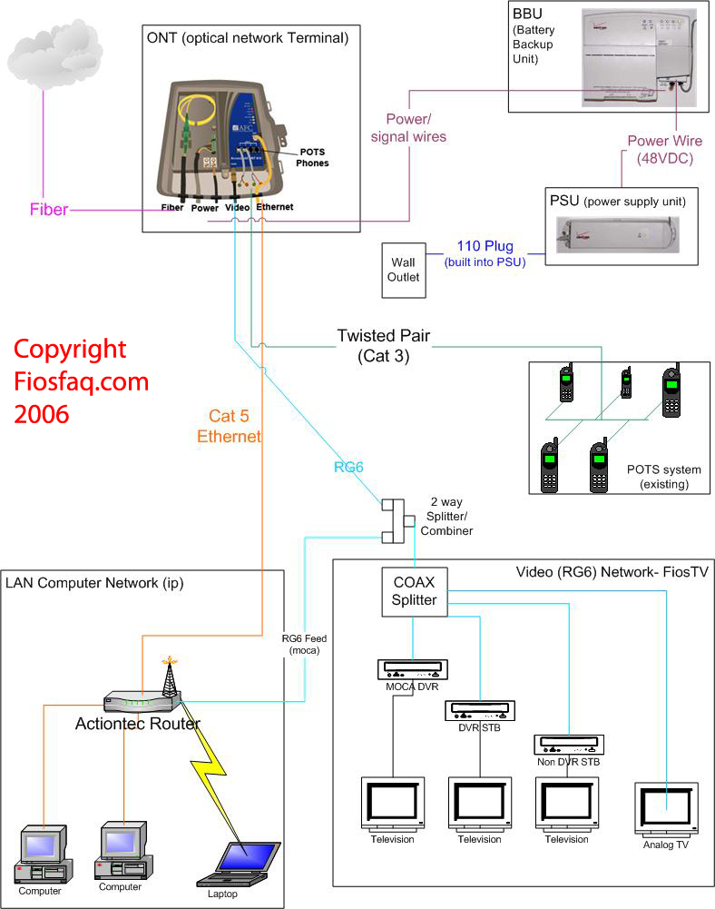

Slide 23
Cable vs. FiOS
Cable
Pros
fast speed
available in most areas
Cons
bandwidth shared with other users
FiOS
Pros
fast speed
dedicated service (bandwidth not shared)
Cons
difficult to install (takes longer time)
not available in some areas
http://broadbandnow.com/compare/Verizon-Fios-vs-Comcast-Xfinity

Slide 24
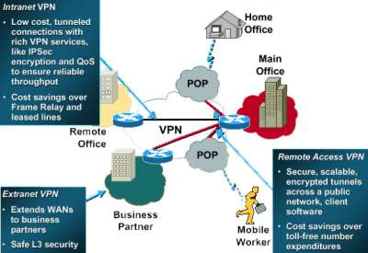
Virtual Private Network (VPN)
A private network constructed within a public network infrastructure, such as the global internet

Slide 25
VPN Basic Architecture
Lease an Internet connection at your speed
Connect a VPN device (router or switch) to each Internet access circuit: purpose is to create a VPN tunnel through the Internet
Sender VPN device encapsulates packet for transfer through the Internet; may encrypt for security (e.g., IPsec)
Receiver’s VPN device strips off the VPN packet and delivers the initial packet to destination; decrypt here

Slide 26
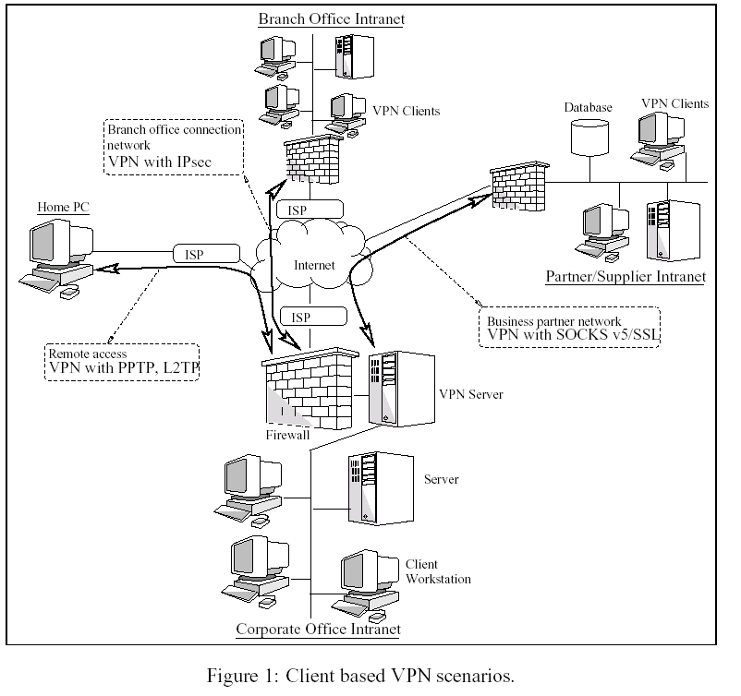

Slide 27
VPN Pros & Cons
Advantages
Low cost: mainly ISP access
Flexibility: can get on network from anywhere
Disadvantages
Traffic on the Internet is unpredictable
Security is always a concern on the Internet despite encryption

